Slide 1
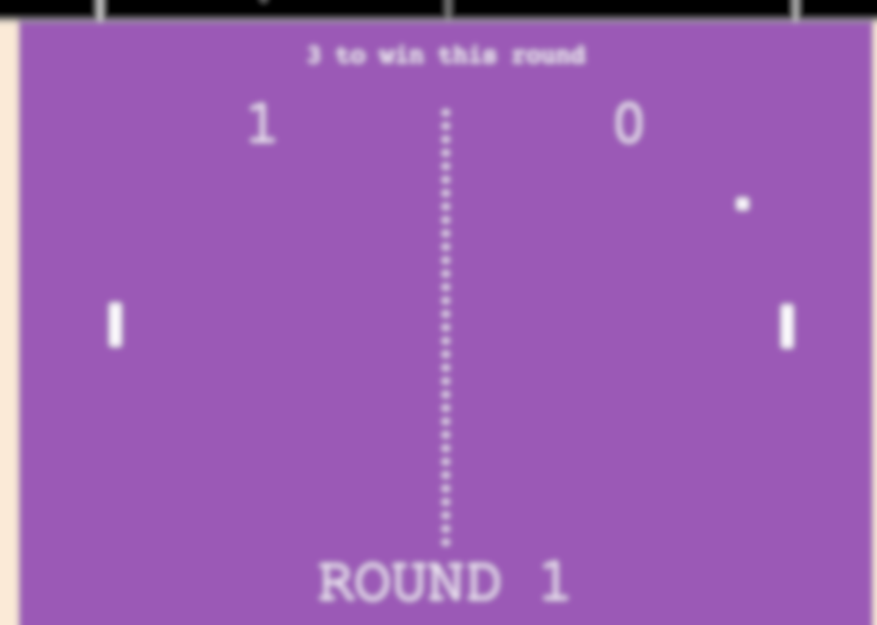
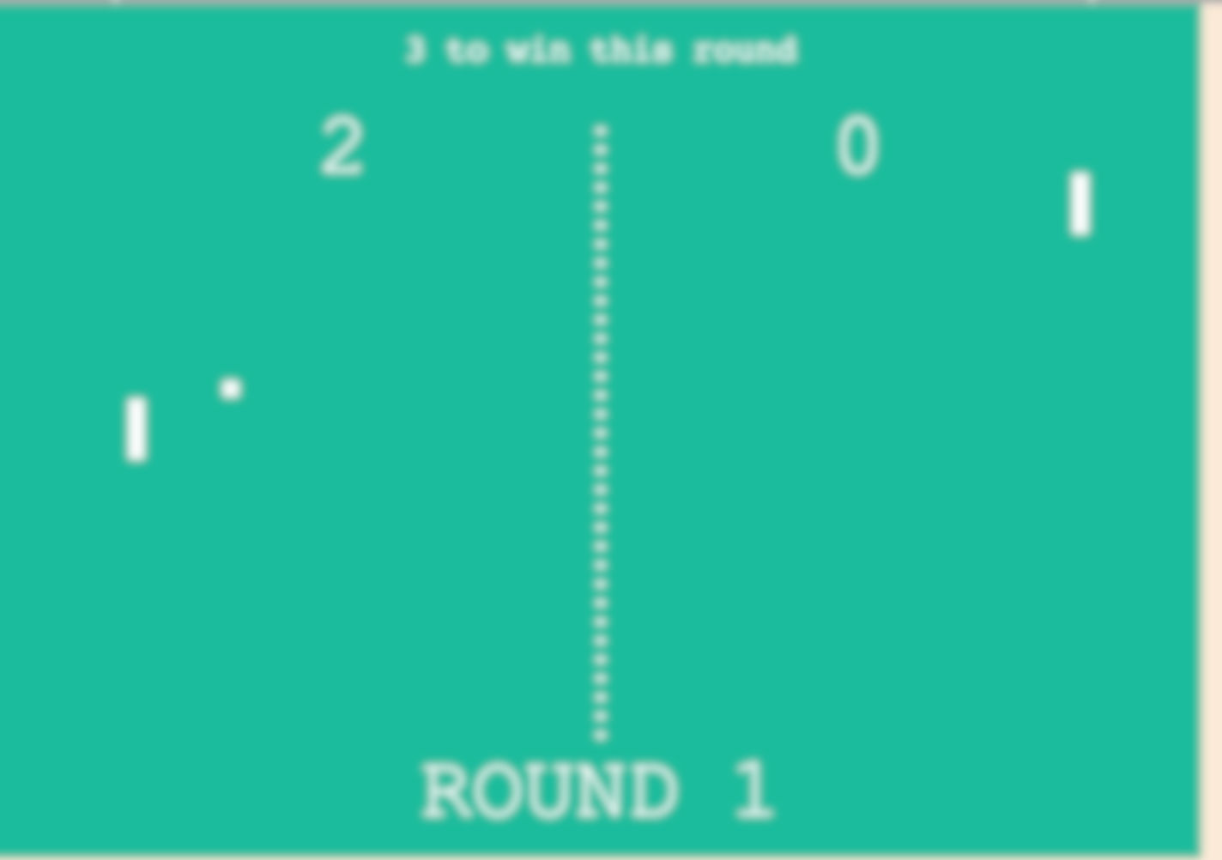
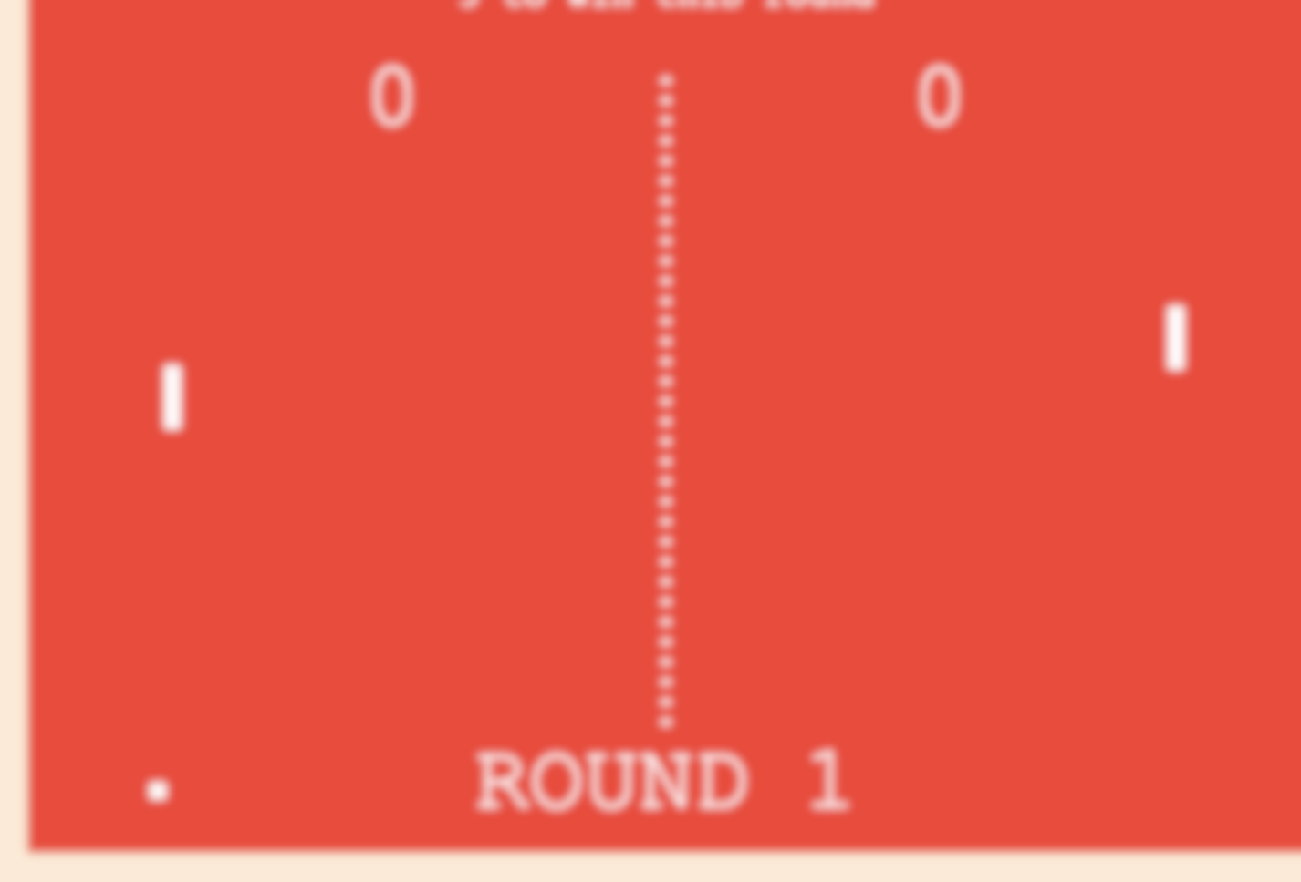
The Greatest
Pong Game of All Time
Adin Geist

Slide 2
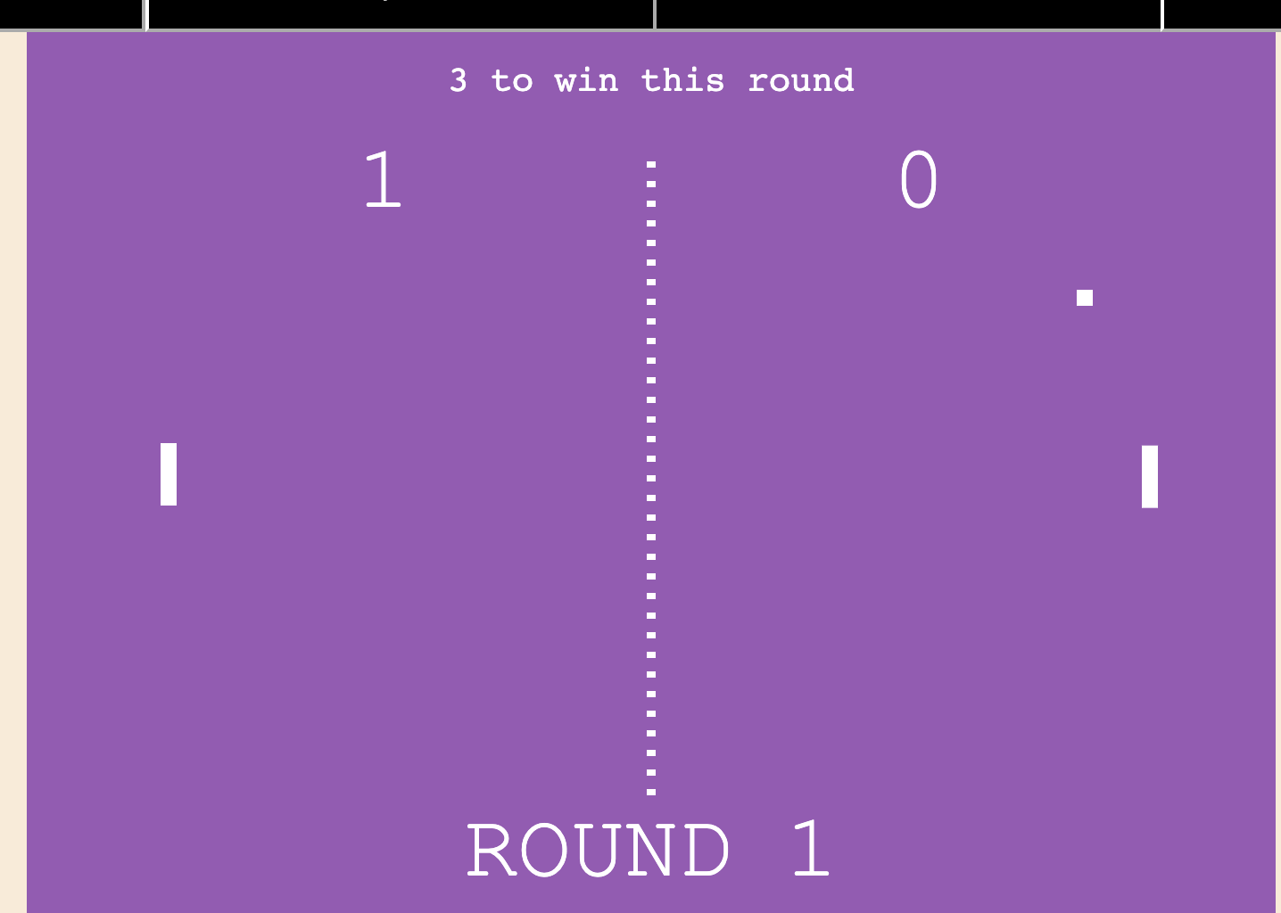
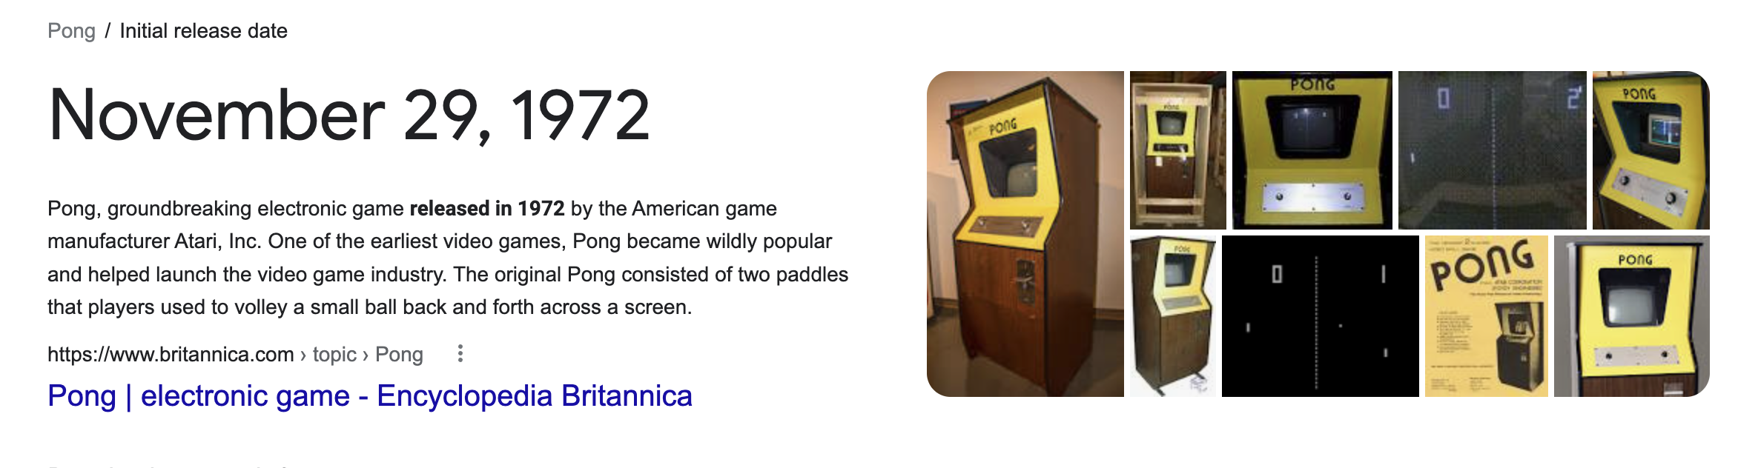
My mission is simple.
Create a JavaScript game that’s straightforward and is engaging
Revise the 1972 classic to have a modern feel
Add modern-day sound effects and vibrant colors to captivate anyone playing/watching the game. This will give the project a great theme and appeal the target audience, game enjoyers.

Slide 3
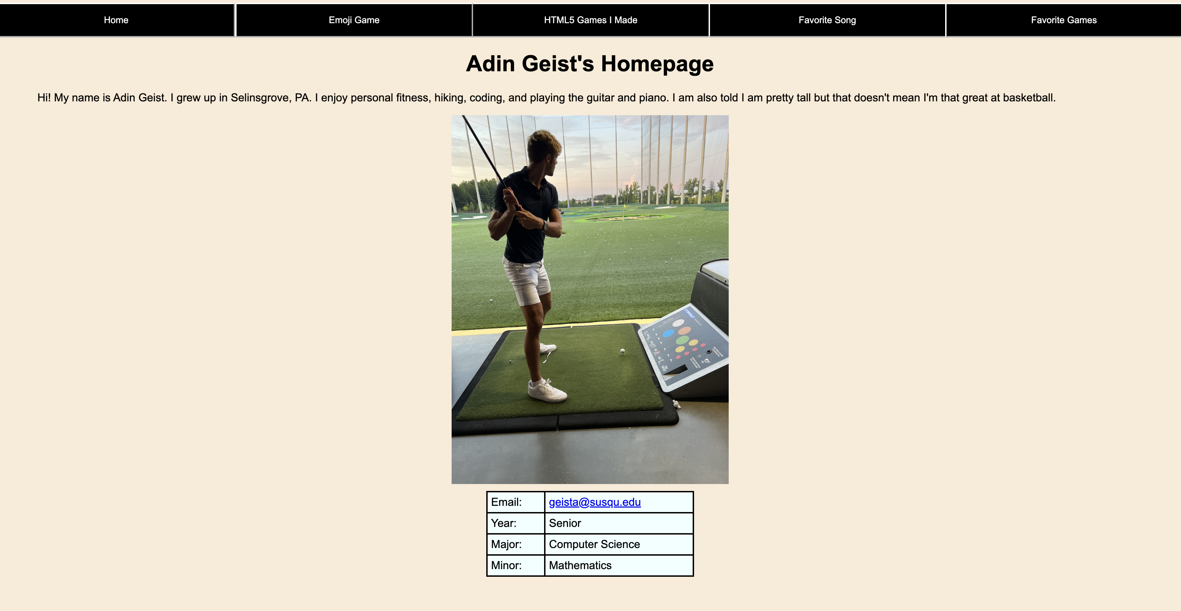
Agenda.
Demonstration live on my homepage.
https://adingeist.github.io/VanillaHTMLSite/
Explain the complex JavaScript concepts

Slide 4
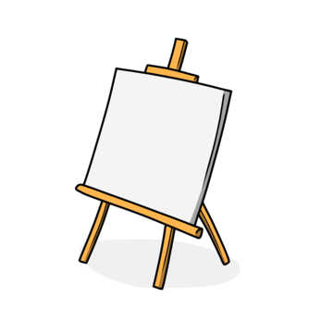
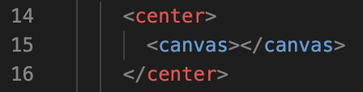
HTML
Ignoring the navigation bar, that’s it.
The game is built entirely using the HTML <canvas> element

Slide 5
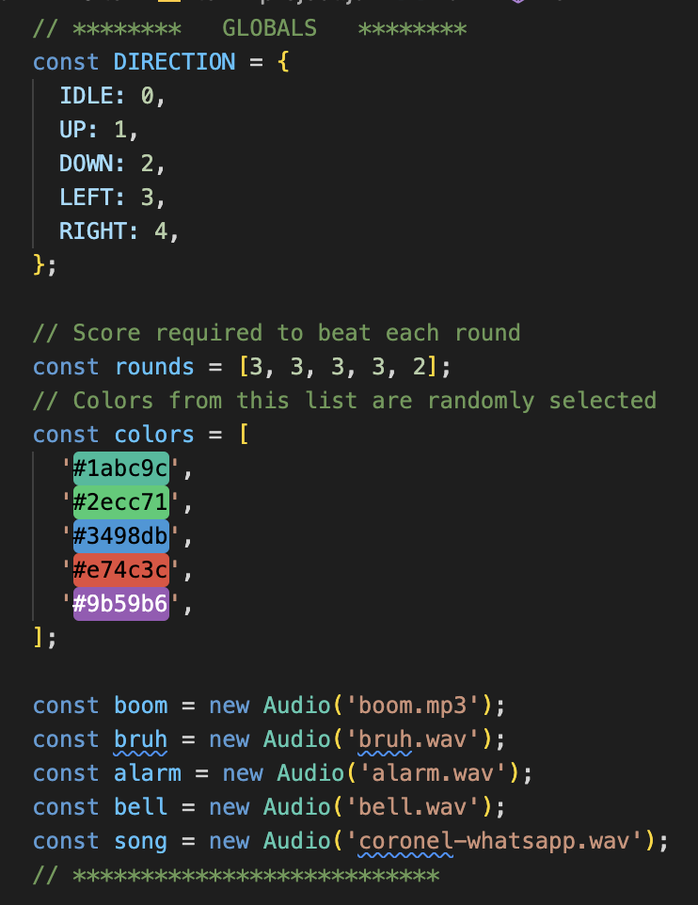

JavaScript - Global variables
DIRECITON – fake enum type we use to test where the ball or paddles are heading
rounds – score to beat each round
colors – list of possible BG colors
Load audio instances to use throughout the application

Slide 6
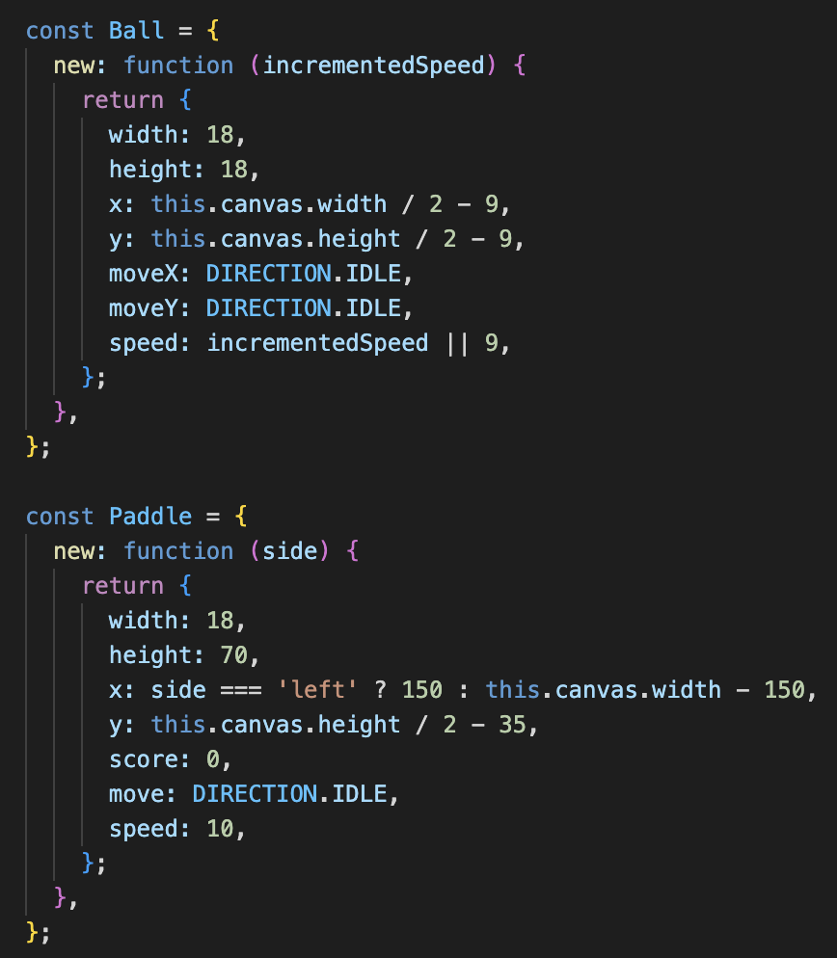
JavaScript – Ball and Paddles
Ball – contains a function to create a new Ball with an adjustable speed
Paddle – contains a function to create a new paddle on the left or right side of the game

Slide 7
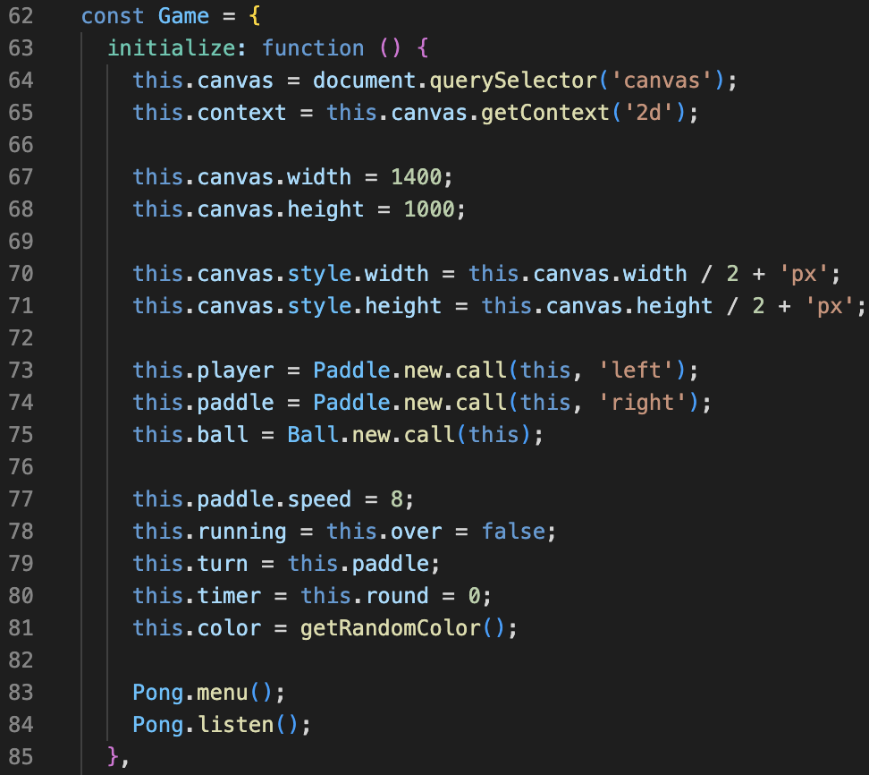
JavaScript – Game object
Initialize the canvas from in the HTML to be 1400x1000px
Create a ball
Create a paddle on the left and right
Prepare the game
Listen for a key to start the game

Slide 8
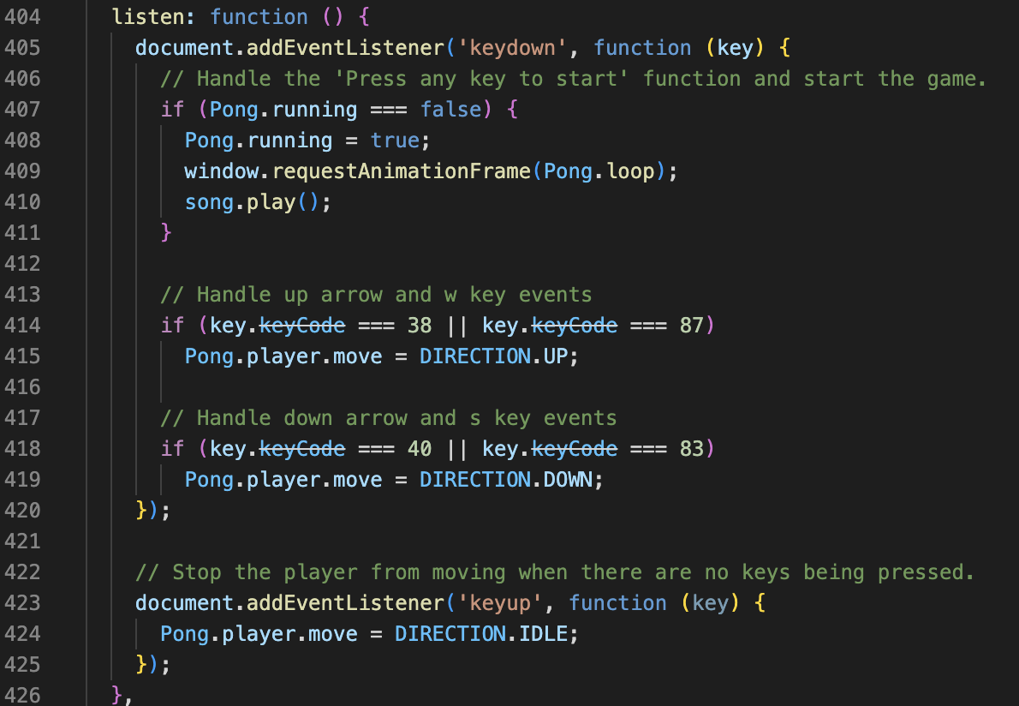
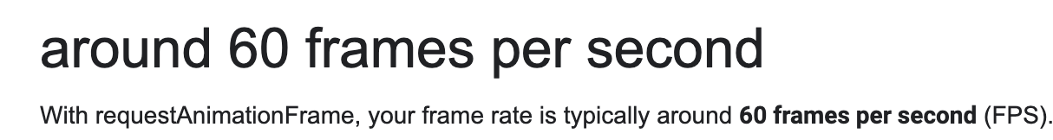
JavaScript – Listen for keypresses
When the key a key is pressed
Game is running
Play “coronel-whatsapp.mov” to add aesthetic appeal to the game
window.requestAnimationFrame() calls the loop/draw board around 60fps
We should check if the key is W or ⬆️
If so, immediately send the player paddle upward
We should also check for S or ⬇️
If so, immediately send the player paddle downward

Slide 9
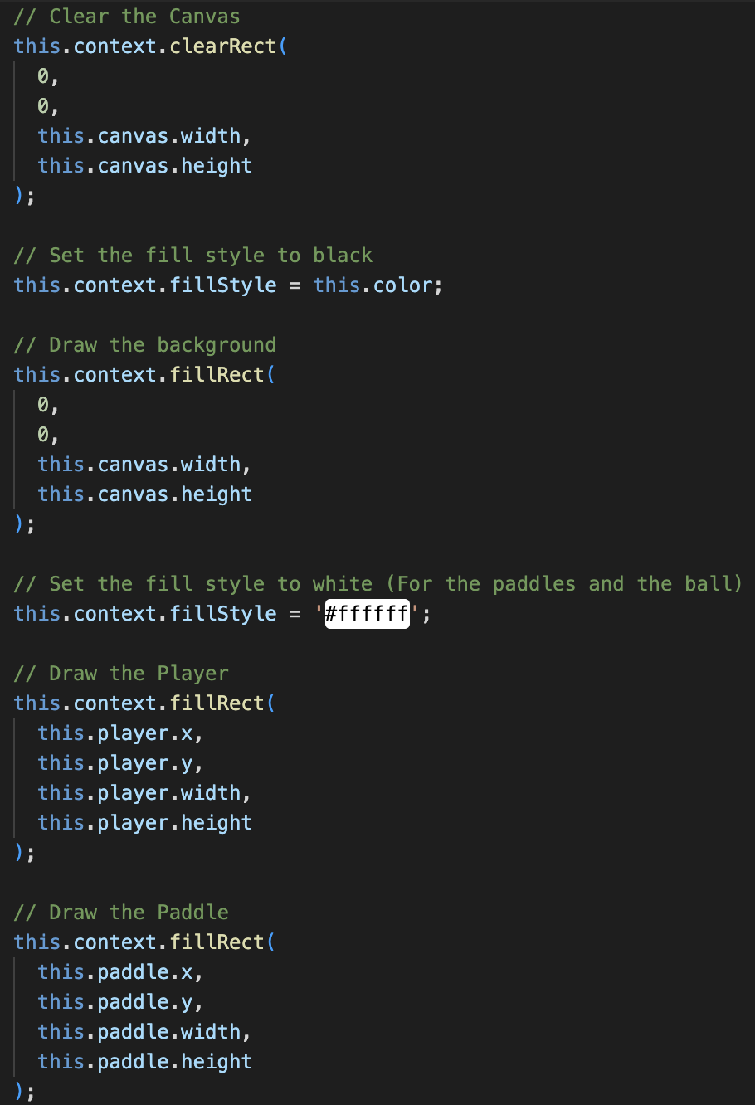
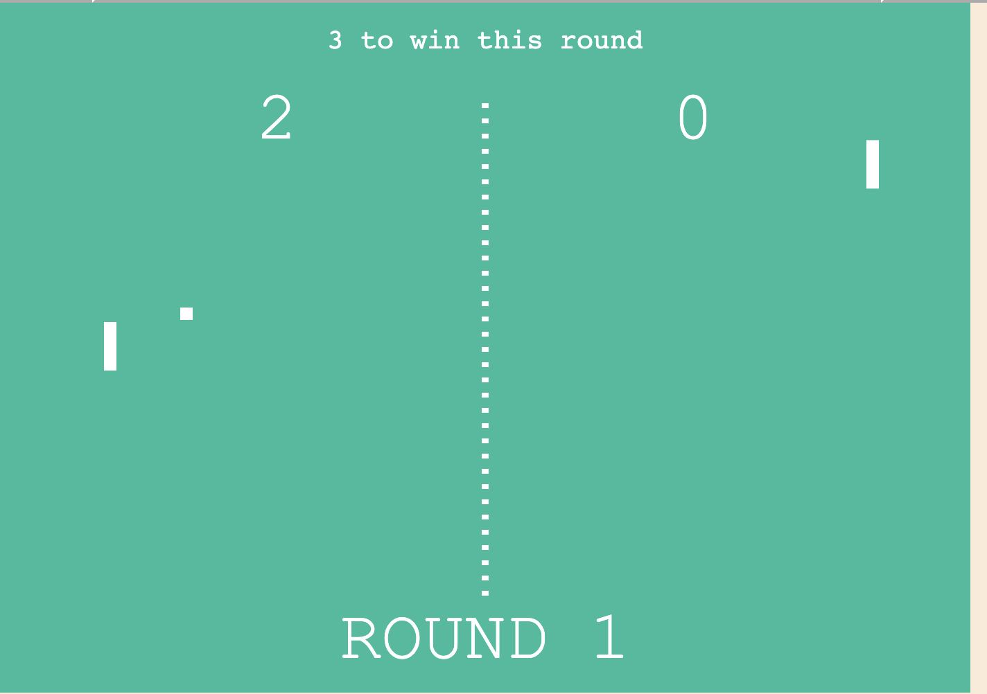
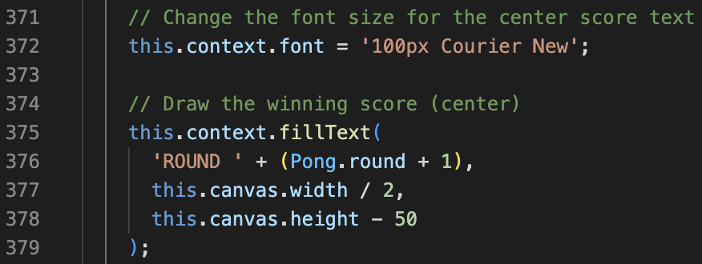
JavaScript – The draw function
Clear the old canvas
Draw a new rectangle as the new canvas
Draw the ball and paddles
Create text to decorate the screen

Slide 10
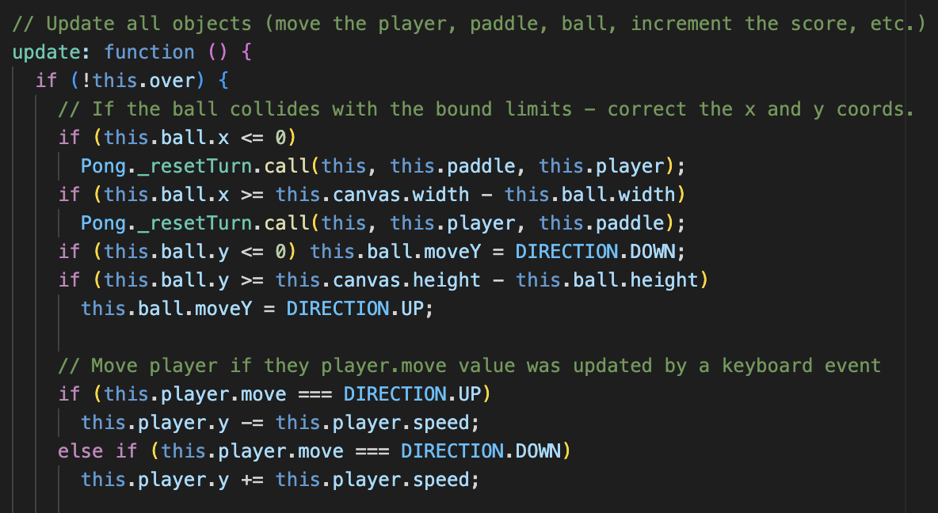
JavaScript – Update function
Every time in the game loop, the game will check if the ball is colliding with something and set how to draw the next frame
Play “boom.wav” on a collision

Slide 11
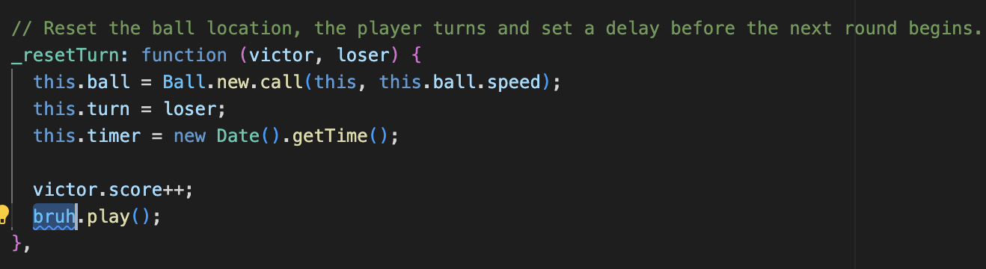
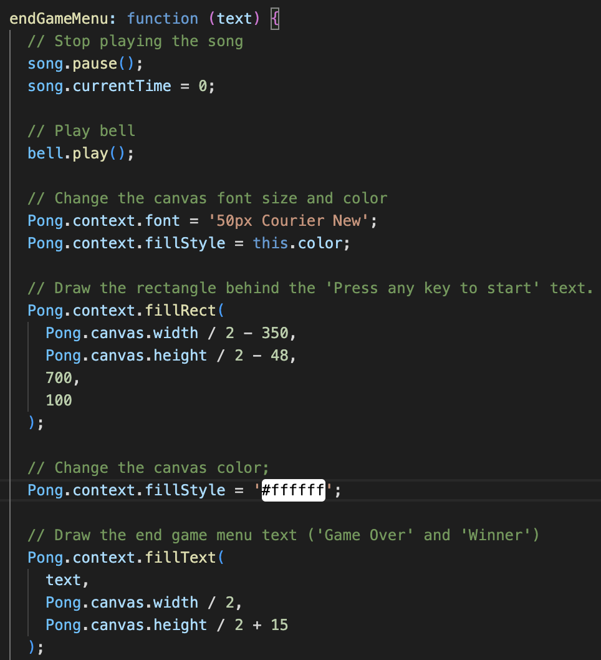
JavaScript – Update function cont.
When the ball goes off the screen
Check which side of the screen it went off, adjust score accordingly
For artistic expression, “bruh.wav” is played
Start the next round if the player won
If the game is over play ”bell.wav” and write the text “Winner!” or ”Game Over!” on the canvas depending on who won

Slide 12
That was a look at
The Greatest Pong Game of All Time
Adin Geist

